Slide 1
The Complex Numbers
10.8

Slide 2
The Number i
i is the unique number for which and so we have i ² = –1.
Imaginary Numbers
An imaginary number is a number that can be written in the form a + bi, where a and b are real numbers and
We can now express the square root of a negative number in terms of i.

Slide 3
Example
Express in terms of i:
Solution

Slide 4
Complex Numbers
A complex number is any number that can be written in the form a + bi, where a and b are real numbers. (Note that a and b both can be 0.)
The following are examples of imaginary numbers:
Here a = 7, b =2.

Slide 5
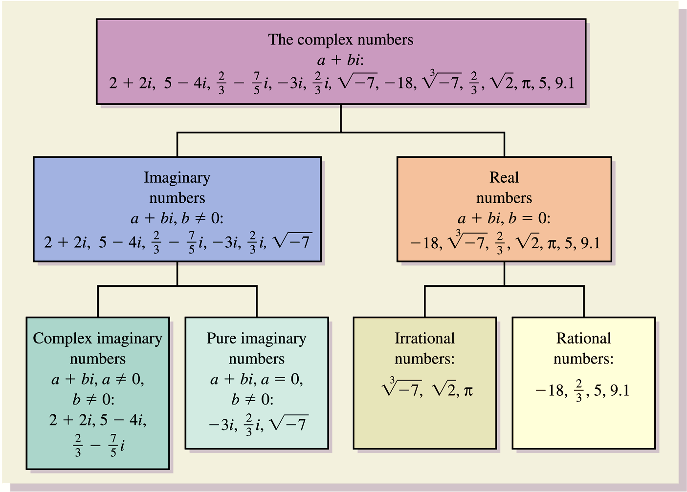

Slide 6
Addition and Subtraction
The complex numbers obey the commutative, associative, and distributive laws. Thus we can add and subtract them as we do binomials.

Slide 7
Example
Add or subtract and simplify.

Slide 8
Multiplication
To multiply square roots of negative real numbers, we first express them in terms of i. For example,
Caution!
With complex numbers, simply multiplying radicands is incorrect when both radicands are negative:

Slide 9
Example
Multiply and simplify. When possible, write answers in the form a + bi.
Solution

Slide 10
Solution continued

Slide 11
Conjugate of a Complex Number
The conjugate of a complex number a + bi is a – bi, and the conjugate of a – bi is a + bi.

Slide 12
Example
Find the conjugate of each number.
Solution
The conjugate is 4 – 3i.
The conjugate is –6 + 9i.
The conjugate is –i.

Slide 13
Conjugates and Division
Conjugates are used when dividing complex numbers. The procedure is much like that used to rationalize denominators.

Slide 14
Example
Divide and simplify to the form a + bi.
Solution

Slide 15
Solution continued

Slide 16
Powers of i
Simplifying powers of i can be done by using the fact that i ² = –1 and expressing the given power of i in terms of i ². Consider the following:
i ²³ = (i ²)¹¹i¹
= (–1)¹¹i = –i

Slide 17
Example
Simplify:
Solution

