Slide 1
Section 12.2
Exponential Functions

Slide 2
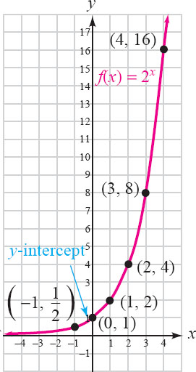
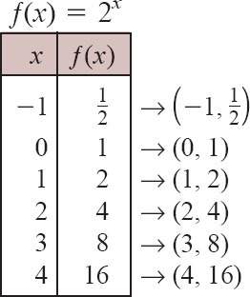
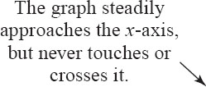
EXAMPLE
Graph ƒ(x) = 2^{x}
Solution

Slide 3
Exponential Functions
An exponential function with base b is defined by the equations
ƒ(x) = b^{x} or y = b^{x}
where b > 0, b ≠ 1, and x is a real number.

Slide 4
Graph Exponential Functions.
Properties of Exponential Functions:
The domain of the exponential function ƒ(x) = b^{x} is (−∞, ∞).
The range is the interval (0, ∞) .
The graph has a y-intercept of (0, 1).
The x-axis is called an asymptote of the graph.

Slide 5
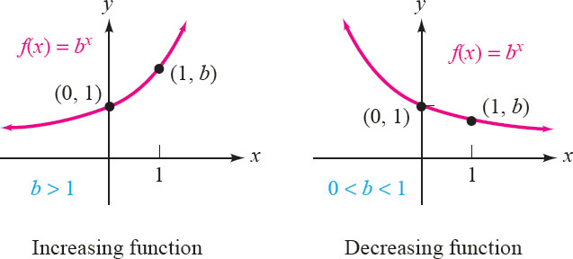
Graph Exponential Functions.
Increasing and Decreasing Functions
If b > 1 then ƒ(x) = b^{x} is an increasing function.
If 0 < b < 1, then ƒ(x) = b^{x} is a decreasing function.

Slide 6
EXAMPLES
Graph
ƒ(x) = 10^{x}
ƒ(x) = -10^{x}
ƒ(x) = 10^{x}+2
ƒ(x) = 10^{x-3}
ƒ(x) = 10^{x+4} - 5

Slide 7
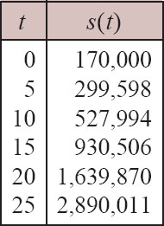
EXAMPLE
Professional Baseball Salaries. The exponential function s(t) = 170,000(1.12)^{t} approximates the average salary of a major League baseball player, where t is the number of years after 1980 and 0 ≤ t ≤ 25. Sketch the graph of the function. (Source: Baseball Almanac)
The function values for t = 0 and t = 5 are computed as follows:
Using a scientific calculator, we find the corresponding values of s(t) for t-values of 10, 15, 20, and 25 and list them in a table :

Slide 8
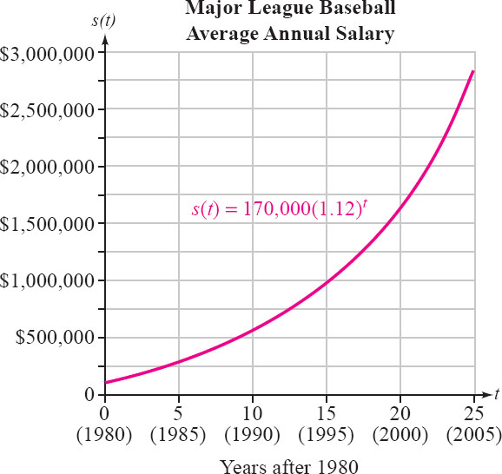
EXAMPLE 5
Professional Baseball Salaries. The exponential function s(t) = 170,000(1.12)^{t} approximates the average salary of a major League baseball player, where is the number of years after 1980 and 0 ≤ t ≤ 25. Sketch the graph of the function. (Source: Baseball Almanac)
Solution
Then we plot the ordered pairs and draw a smooth curve through them to get the graph.

Slide 9
Use Exponential Functions in Applications Involving Growth or Decay.
Formula for Compound Interest: If $P is deposited in an account and interest is paid k times a year at an annual rate r, the amount A in the account after t years is given by

