Slide 1
Sections 7.1, 7.2 Functions and Domain

Slide 2
Definitions
A relation is a correspondence between a first set
called the domain, and a second set, called the range,
such that each member of the domain corresponds
to at least one member of the range.
A function is a relation in which each member of the
domain corresponds to exactly one member of the range.

Slide 3
f
x₁
x₂
y₁
y₂
x₃
y₃
X
Y
Domain
Range

Slide 4
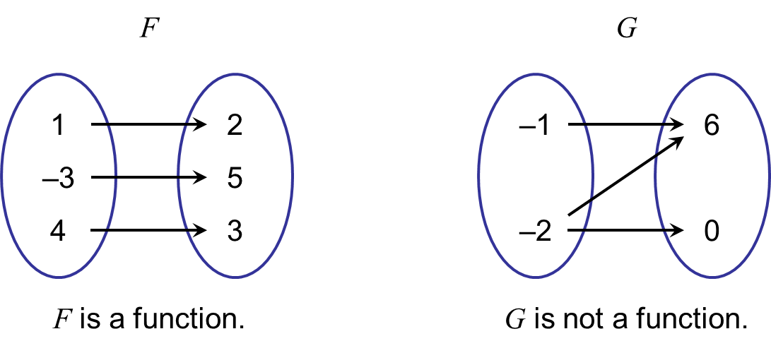
Examples
Determine if the correspondence is a function.
8
0
–5
2
17

Slide 5
Example
Determine if the correspondence is a function.
Jackson
Max
Cade
Football
Wrestling
Soccer
Solution
It is not a function because a member of the domain (Jackson) corresponds to more than one member of the range.

Slide 6
Examples
Not a function
Function
Function

Slide 7
The Vertical Line Test
If it is possible for a vertical line to cross a graph more than once, then the graph is not the graph of a function.
Not a function. Three y-values correspond to one x-value
A function
Not a function. Two y-values correspond to one x-value

Slide 8
Function Notation
f (x)
Read: “f of x”
f is the name of the function
x is the variable into which we substitute values or other expressions
x is called the independent variable and f(x) is the dependent variable.

Slide 9
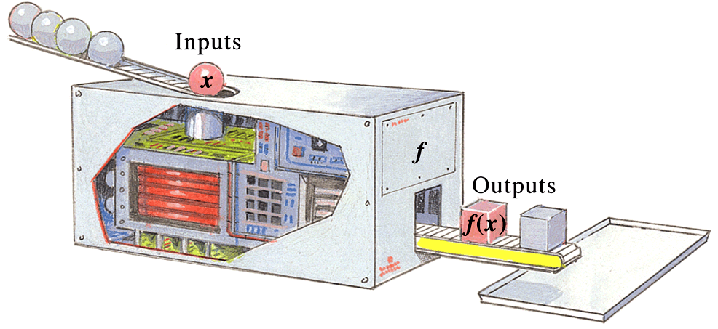
Function Notation
To understand function notation, it helps to imagine a “function machine.” Think of putting a member of the domain (an input) into the machine. The machine is programmed to produce the appropriate member of the range (the output). Here x represents an arbitrary input, and f (x) represents the corresponding output.

Slide 10
Function Notation
Most functions are described by equations. For example, f (x) = 5x +2 describes the function that takes an input x, multiplies it by 5 and then adds 2.
Input
f (x) = 5x + 2
To calculate the output f (3), take the input 3, multiply it by 5, and add 2 to get 17. That is, substitute 3 into the formula for f (x).
f (3) = 5(3) + 2 = 17

Slide 11
Examples
Find each indicated function value.
a) f (–2), for f (x) = 3x ² + 2x
b) g(4), for g(t) = 6t + 9
c) h(m +2), for h(x) = 8x + 1
Solution
a) f (–2) = 3(–2)² + 2(–2) = 12 – 4 = 8
b) g(4) = 6(4) + 9 = 24 + 9 = 33
c) h(m +2) = 8(m+ 2) + 1 = 8m + 16 + 1 = 8m + 17

Slide 12
Examples
Let f(x)=2x – 3 and g(m) = | m² – 2m + 1|. Determine:
f(-3)
g(-2)
f(a)
g(a + 1)

Slide 13
Examples
For the function f represented below, determine each of the following.
y
a) f(-2)
b) f(3)
7
6
5
4
f
3
2
1
-5 -4 -3 -2 -1 1 2 3 4 5
-1
x
-2
-3
-4

Slide 14
a) f(-2)
Solution
y
7
6
5
f
4
3
Output
2
1
-5 -4 -3 -2 -1 1 2 3 4 5
Input
-1
x
-2
-3
-4

Slide 15
Domain and Range
When a function is given as a set of ordered pairs, the domain is the set of all first coordinates and the range is the set of all second coordinates.
Find the domain and range for the function f given by
f = {(–5, 1), (1, 0), (3, –5), (4, 3)}.
Solution
The domain is the set of all first coordinates: {–5, 1, 3, 4}.
The range is the set of all second coordinates: {1, 0, –5, 3}.

Slide 16
Example
Find the domain and range of the function f shown here.
y
7
6
5
4
f
3
2
1
-5 -4 -3 -2 -1 1 2 3 4 5
-1
x
-2
-3
-4

Slide 17
The domain of f
Solution
y
The domain of f is the set of all x-values that are used in the points on the curve. These extend continuously from -5 to 3 and can be viewed as the curve’s shadow, or projection, on the x-axis. Thus the domain is
7
6
5
f
4
3
2
1
-5 -4 -3 -2 -1 1 2 3 4 5
-1
x
The domain of f
-2
-3
-4

Slide 18
The range of f
Solution
y
The range of f is the set of all y-values that are used in the points on the curve. These extend continuously from -1 to 7 and can be viewed as the curve’s shadow, or projection, on the y-axis. Thus the range is
7
6
The range of f
5
f
4
3
2
1
-5 -4 -3 -2 -1 1 2 3 4 5
-1
x
-2
-3
-4

Slide 19
Determine the domain, range, and intercepts of the following graph.
y
4
(2, 3)
(10, 0)
0
(1, 0)
(4, 0)
x
(0, -3)
-4

Slide 20
Example
Determine the domain of
Solution
We ask, “Is there any number x for which we cannot compute 3x² – 4?” Since the answer is no, the domain of f is (-∞, ∞) the set of all real numbers.

Slide 21
Examples
Find the domain of the following functions:
Domain: All Real Numbers or (-∞, ∞)
(a)
Domain: All Real Numbers except 1 or (-∞, 1) ∪ (1, ∞)
(b)

Slide 22
Examples
Find the domain of the following functions:
Domain: All Real Numbers or (-∞, ∞)
(a)
(b)
Domain: All Real Numbers except 1 and -7/3 or (-∞, -7/3) ∪ (-7/3,1) ∪ (1, ∞)

