Slide 1
Section 1.1 Slopes and Equations of Lines

Slide 2
Slope of a line
If a line passes through two points (x₁,y₁) and (x₂,y₂), then its slope is given by
The slope of a horizontal line is 0
The slope of a vertical line is undefined

Slide 3
Slope-Intercept form of a line
If a line has slope m and y-intercept (0,b), then the equation of the line is given by

Slide 4
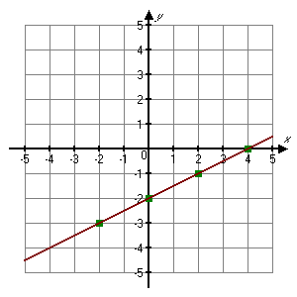
Example
Graph
Solution:
The y-intercept is
(0, −2).

Slide 5
Point-Slope form of a line
If a line has slope m and passes through a point (x₁,y₁), then the equation of the line is given by

Slide 6
Example
Find the equation of the line containing the points (2, 7) and (−1, −8).
Solution:
First determine the slope:
Using the point-slope equation,

Slide 7
Horizontal and vertical lines
Horizontal line has equation of the form
Vertical line has equation of the form

Slide 8
General Form of a Line
Examples:
2x + y = 10
x – 5 = 1
3y – 9 = 0

Slide 9
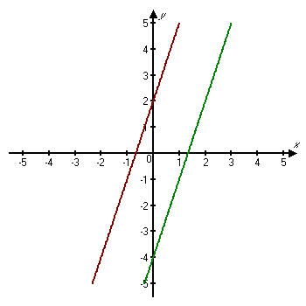
Parallel Lines
Vertical lines are parallel. Nonvertical lines are parallel if and only if they have the same slope and different y-intercepts.
y = 3x + 2
y = 3x − 4

Slide 10
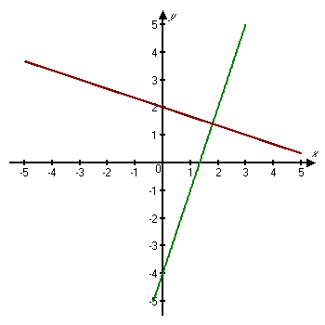
Perpendicular Lines
Two lines with slopes m₁ and m₂ are perpendicular if and only if the product of their slopes is −1: m₁m₂ = −1.
Lines are also perpendicular if one is vertical (x = a) and the other is horizontal (y = b).
y = 3x − 4

Slide 11
Examples
Determine whether each of the following pairs of lines is parallel, perpendicular, or neither.
a) y − 4x = − 3, 4y − 8 = − x
(perpendicular)
b) 2x + 3y = 4, 3x + 2y = 8
(neither)
c) 2y = 4x + 12, y − 8 = 2x
(parallel)

Slide 12
Example
Write an equation of the line containing the point (1, − 2) and is
(a) parallel to the line 3y + 4 = 18x.
(b) perpendicular to the line 3y + 4 = 18x.
Solution:
Solve the equation for y:
So, its slope is 6.

Slide 13
Example continued
The line parallel to the given line will have the same slope, which is 6.

Slide 14
Example continued
(b) For a line perpendicular, its slope will be
m =

