Slide 1
Section 11.1 Limits

Slide 2
Exploring
Compare the following 2 functions
a) Find g(1), g(2) and g(3)
b) Find f(1), f(2) and f(3)

Slide 3
Exploring
f(2) = undefined, but g(2) = 4
What happens to these 2 functions when x is very close to 2?
As x gets closer and closer to 2 from both sides, both f(x) and g(x) approach 4 from both sides.
We write and
x | 1 | 1.5 | 1.9 | 1.99 | → | 2 | ← | 2.001 | 2.1 | 2.5 | 3
f(x) | 3 | 3.5 | 3.9 | 3.99 | → |  | ← | 4.001 | 4.1 | 4.5 | 5
g(x) | 3 | 3.5 | 3.9 | 3.99 | → |  | ← | 4.001 | 4.1 | 4.5 | 5
x | 1 | 1.5 | 1.9 | 1.99 | → | 2 | ← | 2.001 | 2.1 | 2.5 | 3
f(x)
g(x)
4
4

Slide 4
Definition
If f(x) approaches b as x approaches a from both sides, we will write
and b is called the limit of the function f(x) as x approaches a.
We also write
if f(x) approaches b as x → a from the left,
if f(x) approaches b as x → a from the right.

Slide 5
Finding limits numerically
Find the following limit by using a table of numbers.

Slide 6
Remarks
Limit does not exist (dne) if f(x) does not approach any constant.
still exists even though f(a) is undefined.
If , then = dne.
If f(x) gets larger and larger without bound as x→a, we will write
If f(x) gets larger and larger in the negative direction as x→a, we will write

Slide 7
Existence of a Limit
f (x₁)
•
f (x₁)
•
f (a) = L
f(a) ≠ L
o
f (x₂)
•
f (x₂)
•
|
x₁
|
a
|
x₂
|
x₁
|
a
|
x₂

Slide 8
Nonexistence of a Limit
L₂
•
•
L₁
|
x
|
a
|
x

Slide 9
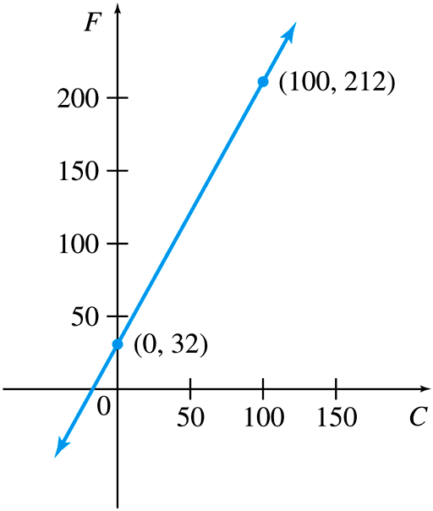
Find limits graphically
Given the graph of f(x). Find the following limit.

Slide 10
Finding limits algebraically
Rules for Limits (Read page 657)
We can use this property whenever possible
This means we can do a direct substitution if possible.
Otherwise, we can simplify the expression first:
Factor and cancel common factors
Expand and collect like terms (if parentheses are present)
Rationalize the numerator or denominator (if root is present)
Then use direct substitution.

Slide 11
Examples
Find the following limit algebraically.

Slide 12
Examples
Find the following limit algebraically.

Slide 13
As x approaches infinity
f(x) → ? as x gets larger and larger
f(x) → ? as x gets larger and larger in the negative direction
f (x)
•
Fun Fact: A student, who is an excellent pattern-observer, was asked to find the following limit. He quickly answered
8
|
x
x → ∞
7

Slide 14
Limit at infinity
If as x approaches infinity (or negative infinity), f (x) approaches L, then the limit as x approaches a of f (x) is L.
f (x)
•
L
|
x
x → ∞

Slide 15
Horizontal Asymptote
The line y = L is called a horizontal asymptote of the curve y = f(x) if either
L
f
or

Slide 16
Examples
Since
f(x) = e ^{x} has a horizontal asymptote at y = 0
Polynomial Functions have no horizontal asymptotes.

Slide 17
Finding limits at infinity
If n is a positive number, then
To find limits at infinity, we multiply the expression by
where n is the highest power in the denominator.
Then use the above property to simplify.

Slide 18
Examples
Find the limits.

