Slide 1
Section 11.2 Continuity

Slide 2
Existence of a Limit
f (x₁)
•
f (x₁)
•
f (a) = L
f(a) ≠ L
o
f (x₂)
•
f (x₂)
•
|
x₁
|
a
|
x₂
|
x₁
|
a
|
x₂

Slide 3
Nonexistence of a Limit
L₂
•
•
L₁
|
x
|
a
|
x

Slide 4
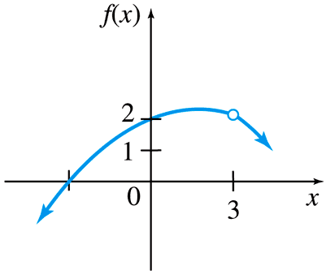
Find limits graphically

Slide 5
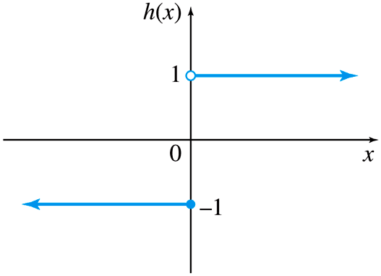
Example

Slide 6
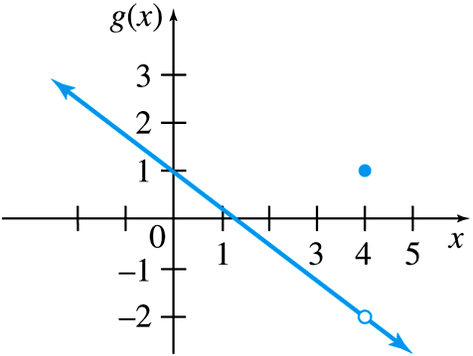
Another Example

Slide 7
Definition
A function is continuous at a number a if
This means you must show that
This implicitly requires that the limit must exist and f (a) must be defined.
The function is discontinuous at x = a if f (a) is undefined. This fact helps us quickly locate where the function is discontinuous

Slide 8
Example
Is f(x) continuous at 2?
No
Is f(x) continuous at 3?
Yes

Slide 9
Example
Find all values of x where the function is discontinuous.

Slide 10
One-sided Continuity
A function f is continuous from the right at a if
and f is continuous from the left at a if
●
○
| a
●
○
| a

Slide 11
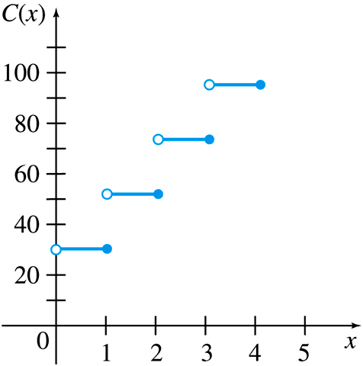
Example
Is C(x) continuous from the left at 1?
Is C(x) continuous from the right at 1?

Slide 12
Continuity on an Interval
A function f(x) is continuous on a closed interval [a,b] if it is continuous
at every number in the open interval (a,b)
from the right at x = a
from the left at x = b.
●
○
●
| b
| a

Slide 13
Example
Determine the interval of continuity.

