Slide 1
2.2
The Limit of a Function

Slide 2
Exploring
Consider the following 2 functions.
a) Find g(1), g(2) and g(3)
b) Find f(1), f(2) and f(3)

Slide 3
Numerical Approach
f (2) = undefined, but g(2) = 4
What happens to these functions when x is very close to 2?
As x gets closer and closer to 2 from both sides, both functions approach 4 from both sides.
We write and
x | 1 | 1.5 | 1.9 | 1.99 | → | 2 | ← | 2.001 | 2.1 | 2.5 | 3
f(x) | 3 | 3.5 | 3.9 | 3.99 | → |  | ← | 4.001 | 4.1 | 4.5 | 5
g(x) | 3 | 3.5 | 3.9 | 3.99 | → |  | ← | 4.001 | 4.1 | 4.5 | 5
x | 1 | 1.5 | 1.9 | 1.99 | → | 2 | ← | 2.001 | 2.1 | 2.5 | 3
f(x)
g(x)
4
4

Slide 4
Definition
If f(x) approaches b as x approaches a from both sides, we will write
and b is called the limit of the function f(x) as x approaches a.
We also write
if f(x) approaches b as x → a from the left,
if f(x) approaches b as x → a from the right.

Slide 5
Remarks
Limit does not exist (dne) if f(x) does not approach any constant.
still exists even though f(a) is undefined.
If , then = dne.
It’s a bad definition; the precise definition is very complicated!

Slide 6
Examples
Find the following limit by using a table of numbers.

Slide 7
Graphical Approach
f (x₁)
•
f (x₁)
•
f (a) = L
f(a) ≠ L
o
f (x₂)
•
f (x₂)
•
|
x₁
|
a
|
x₂
|
x₁
|
a
|
x₂

Slide 8
Nonexistence of a Limit
L₂
•
•
L₁
|
x
|
a
|
x

Slide 9
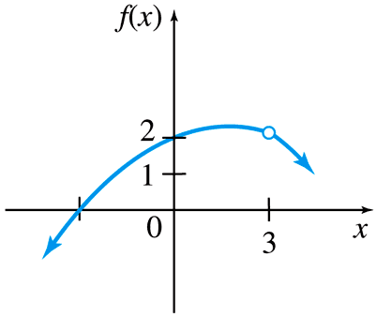
Example

Slide 10
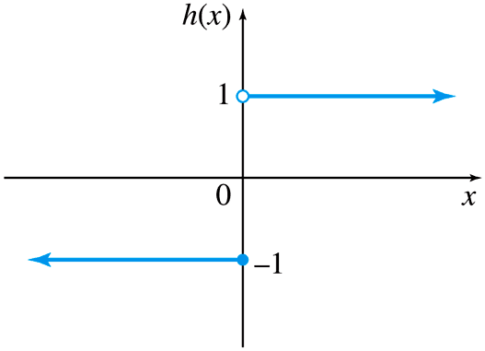
Example

Slide 11
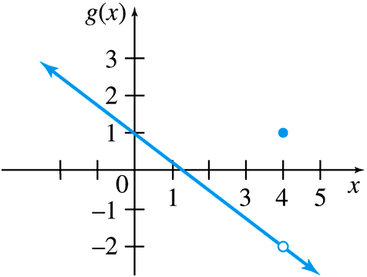
Example

Slide 12
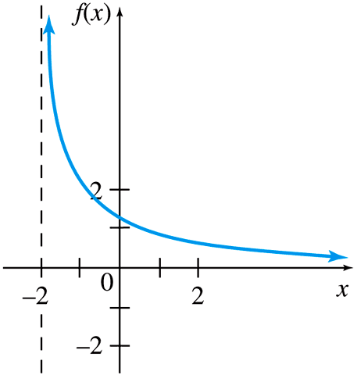
Example

Slide 13
Definition
If f(x) gets larger and larger without bound as x→a, we will write
The notation means that the values of f (x) can be made arbitrarily large (as large as we please) by taking x sufficiently close to a (on either side) but not equal to a.
If f(x) gets larger and larger in the negative direction as x→a, we will write
f
a

Slide 14
Example
Find the limit numerically.
f → ∞
•
•
|
x
|
2
|
x

Slide 15
Vertical Asymptote
The line x = a is called a vertical asymptote of the curve y = f (x) if
or

Slide 16
Examples
1. Find the limits numerically.
(a) (b)
2. Find all vertical asymptotes for each function.

