Slide 1
2.6
Limits at Infinity

Slide 2
As x approaches infinity
f(x) → ? as x gets larger and larger
f(x) → ? as x gets larger and larger in the negative direction
f (x)
•
Fun Fact: A student, who is an excellent pattern-observer, was asked to find the following limit. He quickly answered
8
|
x
x → ∞
7

Slide 3
Limit at infinity
If f(x) approaches L as x approaches ∞ or - ∞, then the limit as x approaches a of f(x) is L.
f (x)
•
L
means that the value of f(x) can be made as close to L as we like by taking x sufficiently large.
|
x
x → ∞

Slide 4
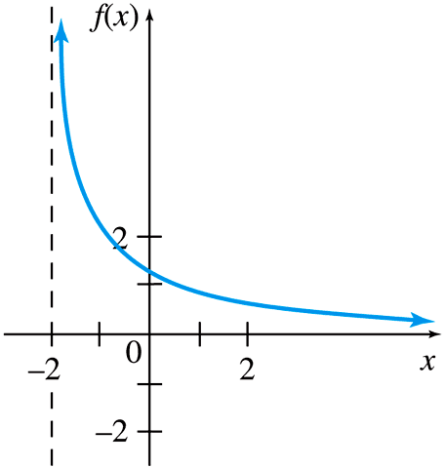
Graphical Approach
Vertical Asymptote:
x = -2
Horizontal Asymptote:
y = 0

Slide 5
Horizontal Asymptote
The line y = L is called a horizontal asymptote of the curve f (x) if either
or
L
f

Slide 6
Examples
Find the limits.

Slide 7
Horizontal Asymptote
Since
f(x) = e^{x} has a horizontal asymptote y = 0
Polynomial functions have no horizontal asymptotes.
Find all horizontal asymptotes of the function.

Slide 8
Finding limits at infinity
If n is a positive number, then
To find limits at infinity, we multiply the expression by
where n is the highest power in the denominator.
Then use the above property to simplify.

Slide 9
Examples
Find the limits.

