Slide 1
2.7
Derivatives and Rates of Change

Slide 2
Secant and Tangent Lines
Secant Line – A line passing through two points on a graph of a function.
Q
f(x₁)
P
f(x₂)
x₁
x₂
Tangent Line – A line that touches the graph at a point. The tangent line may cross the graph at other points depending on the graph.
Q
f(x₁)
P
Q
Q
f(x₂)
f(x₂)
f(x₂)
x₁
x₂
x₂
x₂
http://www.slu.edu/classes/maymk/Applets/SecantTangent.html

Slide 3
Slope of the Secant Line
Now let x₁ = a and x₂ = x. This changes the formula to:
Q
f(a)
P
f(x)
a
x

Slide 4
Slope of the Tangent Line
To determine the slope of the tangent line, let x approach a.

Slide 5
Slope of the Tangent Line (another form)
Now let x₁ = a and x₂ = a+h, where h is the distance from x₁ to x₂. This changes the formula to:
Q
Q
f(x₁)
P
P
f(x₂)
f(a)
f(a+h)
x₁
x₂
a
a + h

Slide 6
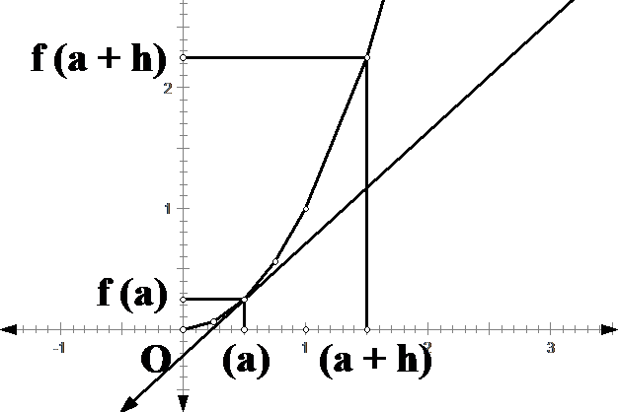
Secant line
Q
Tangent
f (a + h) – f (a)
P
Let h approach 0
h

Slide 7
Slope of the Tangent Line
Q
f(a)
P
f(a+h)
←
a
a + h
means h → 0

Slide 8
Example
Find an equation of a tangent line to f (x) = x² at
x = 3
x = -1
x = 4

Slide 9
Finding slope of the tangent under the “Calc” menu.
Drawing tangent line under the “draw” menu.
slope
tangent equation

Slide 10
The Derivative
The derivative of f at a number a, denoted f ’(a), to be
if the limit exists.
If f ’(a) exists, we say f is differentiable at a.

Slide 11
Interpretations of the Derivative
If f is a function, then f ’ (a) represents
the slope of the tangent line to the graph of f at x =a.
the instantaneous rate of change of f (x) with respect to x when x = a.
the velocity of the object at time x = a if f (x) is the position function of a moving object.

