Slide 1
5.9
Hyperbolic Functions

Slide 2
Graph the following two functions:
These functions show up frequently enough that they
have been given names.
The behavior of these functions shows such remarkable
parallels to trig functions, that they have been given
similar names.

Slide 3
Definitions
Hyperbolic Sine:
(pronounced “cinch x”)
Hyperbolic Cosine:
(pronounced “kosh x”)
Note:

Slide 4
Examples
Show that

Slide 5
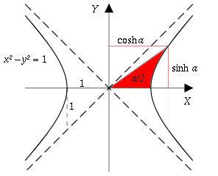
Identities
Note that this is similar to but not the same as:
Now, if we have “trig-like” functions, it follows that we will have “trig-like” identities.

Slide 6
Definitions
Hyperbolic Tangent:
“tansh (x)”
Hyperbolic Cotangent:
“cotansh (x)”
Hyperbolic Secant:
“sech (x)”
Hyperbolic Cosecant:
“cosech (x)”

Slide 7
Identities
Derive some hyperbolic trig identities from the following basic identity.
Derive the double-angle identity, analogous to

Slide 8
Derivaties
Surprise, this is positive!

Slide 9
(quotient
rule)

Slide 10
All derivatives are similar to trig functions except for some of the signs:
Sinh, Cosh and Tanh are positive.
The others are negative.

Slide 11
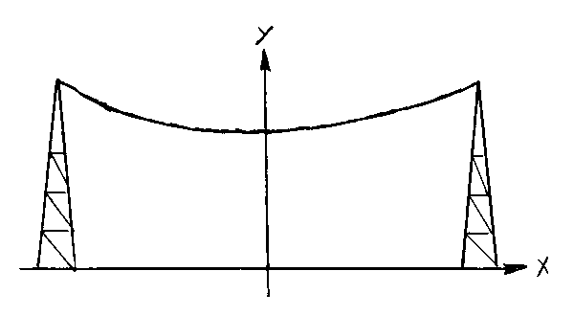
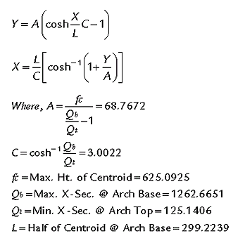
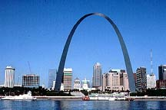
A hanging cable makes a shape called a catenary.
Even though it looks like a parabola, it is not a parabola!
(for some constant a)
Another example of a catenary is the Gateway Arch in St. Louis, Missouri.

Slide 12
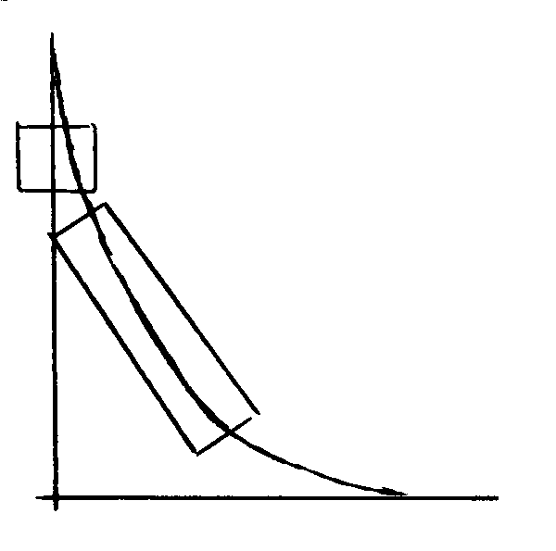
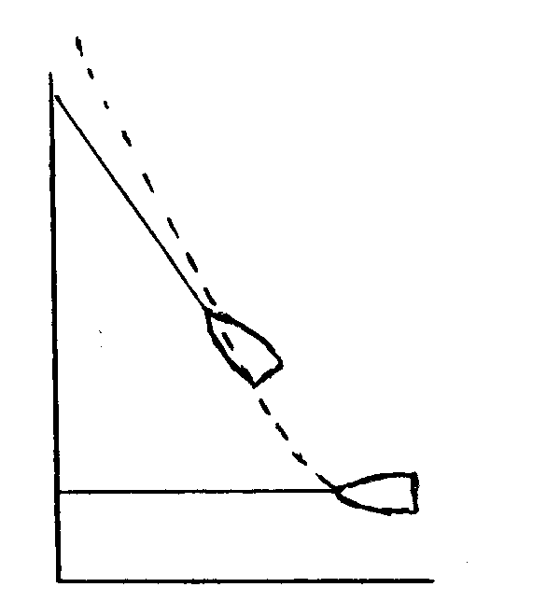
(pursuit curve)
A third application is the tractrix.
An example of a real-life situation that can be modeled by a tractrix equation is a semi-truck turning a corner.
Another example is a boat attached to a rope being pulled by a person walking along the shore.
semi-truck
Both of these situations (and others) can be modeled by:
Other examples of a tractrix curve include a dog leaving the front porch and chasing person running on the sidewalk.
boat

