Slide 1
7.3
Volume: The Shell Method

Slide 2
Example
Find the volume of the region bounded by , , and revolved about the y-axis.
We can use the washer method if we split it into two parts:
inner
radius
cylinder
outer
radius
thickness
of slice
Japanese Spider Crab
Georgia Aquarium, Atlanta

Slide 3
If we take a vertical slice
and revolve it about the
y-axis, we get a cylinder.
If we add all of the cylinders together, we can reconstruct the original object.
cross section
The volume of a thin, hollow cylinder is given by:
r is the x value of the function.
h is the y value of the function.
thickness is dx.

Slide 4
This is called the shell method because we use cylindrical shells.
If we add all the cylinders from the smallest to the largest:

Slide 5
For vertical axis of revolution, the volume is
The Shell Method
For horizontal axis of revolution, the volume is

Slide 6
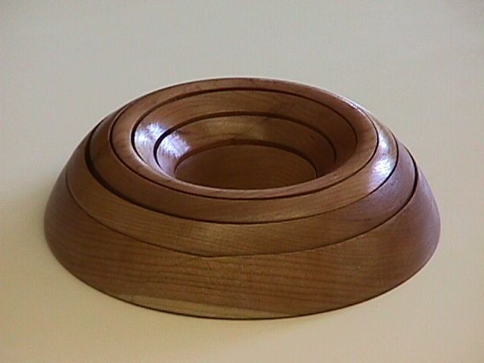
Example
Find the volume generated when this shape is revolved about the y axis.
If we take a vertical slice and revolve it about the y-axis, we get a cylinder.

Slide 7
Disk Method vs. Shell Method
Determine whether a horizontal strip or vertical strip should be used (hint: vertices of the representative rectangle should lie on two different graphs on the entire interval of interest.)
Determine which method is used:
If the strip is perpendicular to the axis of rotation, use the washer method or disk method.
If the strip is parallel to the axis of rotation, use the shell method.

