Slide 1
7.7
Fluid pressure and Fluid Force

Slide 2
Pressure
Pressure is the quantity that measures the amount of force per unit area over the surface of a body. Provided the pressure P is constant over that area we have P = Force /Area
If the liquid has density δ then the pressure P on an object at depth h is P = F/A = δV/A = δ h
The fluid force F is directly related to the pressure
F = PA = δhA
It is equal in all directions
It increases with depth

Slide 3
Units
 | Force | Area | Pressure
International Units (SI) | Newton (nt) | Meter² (m²) | Nt/m² called pascal (mass)
British Units | Pound (lb) | Foot² (ft²) | Lb/ft² (weight)

Slide 4
Example
2 ft
What is the force on the bottom of the aquarium?
3 ft
1 ft

Slide 5
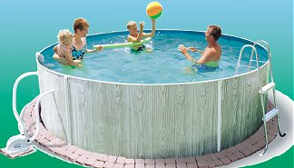
If we had a 1 ft x 3 ft plate on the bottom of a 2 ft deep wading pool, the force on the plate is equal to the weight of the water above the plate.
density
depth
area
All the other water in the pool doesn’t affect the answer!
pressure

Slide 6
Example
What is the force on the front face of the aquarium?
2 ft
Depth (and pressure) are not constant.
If we consider a very thin horizontal strip, the depth doesn’t change much, and neither does the pressure.
3 ft
1 ft
It is just a coincidence that this matches the first answer!
0
depth
density
area
2 ft
2
3 ft

Slide 7
Example
We could have put the origin at the surface, but the math was easier this way.
2 ft
A flat plate is submerged vertically as shown. (It is a window in the shark pool at the city aquarium.)
Find the force on 1 side of the plate
3 ft
Depth of strip:
Length of strip:
Area of strip:
6 ft
density
depth
area

