Slide 1
2.2
Solutions to Separable Equations

Slide 2
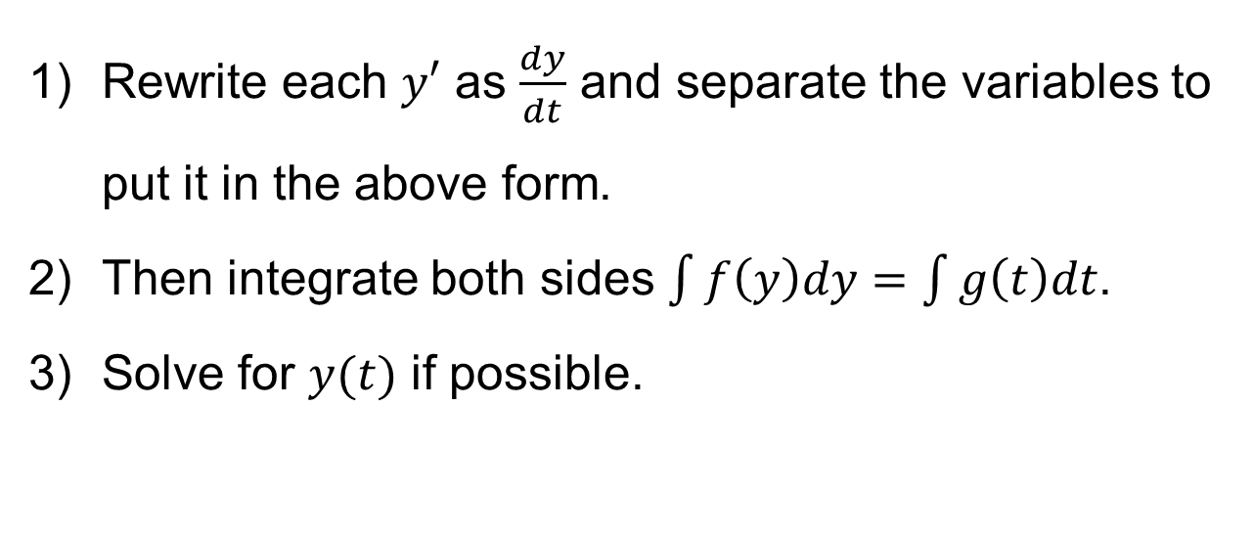
Separable Equations
A separable differential equation is an equation that can be written in the form
$$f\left(y\right)dy=g\left(t\right)dt$$
Rewrite each $y′$ as $\frac{dy}{dt}$ and separate the variables to put it in the above form.
Then integrate both sides $\int{f\left(y\right)dy}=\int{g\left(t\right)dt}$.
Solve for $y(t)$ if possible.

Slide 3
Examples
Find the general solution to the equation.
1) ${3xy}^{′}=4$
2) $y^{′}=e^{3x}(1+y^{2})$
3) $y^{′}=\frac{2xy+2x}{x^{2}−1}$

Slide 4
Examples
1. Solve the following IVP.
$y^{′}=\frac{y^{2}+1}{y}$
This is autonomous equation, in which the independent variable does not appear explicitly in the equation.
2. Find the implicit solution to the equation.
$$y^{′}=\frac{3e^{x}}{y+1}$$

