Slide 1
2.3
Models of Motion

Slide 2
Linear Motion
Consider the height of an object thrown upward with initial velocity $v_{0}$ at the height of $x_{0}$.
Newton’s second Law of Motion: $F=ma$
Gravitational force: $F=−mg$ where $g=32\frac{ft}{s^{2}}=9.8\frac{m}{s^{2}}$
We obtain $a=\frac{d^{2}x}{dt^{2}}=−g$
Solving this equation, we obtain the position function:
$x\left(t\right)=−\frac{1}{2}gt^{2}+v_{0}t+x_{0}$
Air Resistance:
Air resistance force acts in the direction opposite to motion.
$$R(v)=−r(v)∙v$$

Slide 3
Model I
(with air resistance)
Air resistance is proportional to the velocity $R\left(v\right)=−rv$ where $r$ is a constant.
Total force: $F=ma=−mg+R\left(v\right)=−mg−rv$
Divide by m on both sides, we get: $a=−g−\frac{r}{m}v$ or
$\frac{dv}{dt}=−g−\frac{r}{m}v$
This is a separable equation. Solving for v , we obtain
$$v(t)=Ce^{\frac{−rt}{m}}−\frac{mg}{r}$$

Slide 4
Model I
with air resistance
$$v\left(t\right)=\frac{dx}{dt}=Ce^{\frac{−rt}{m}}−\frac{mg}{r}$$
Note that as $t→∞, v→−\frac{mg}{r}$ , the terminal velocity.
Solving for $x\left(t\right)$ , we obtain the position function:
$x\left(t\right)=−\frac{mC}{r}e^{\frac{−rt}{m}}−\frac{mgt}{r}+k$

Slide 5
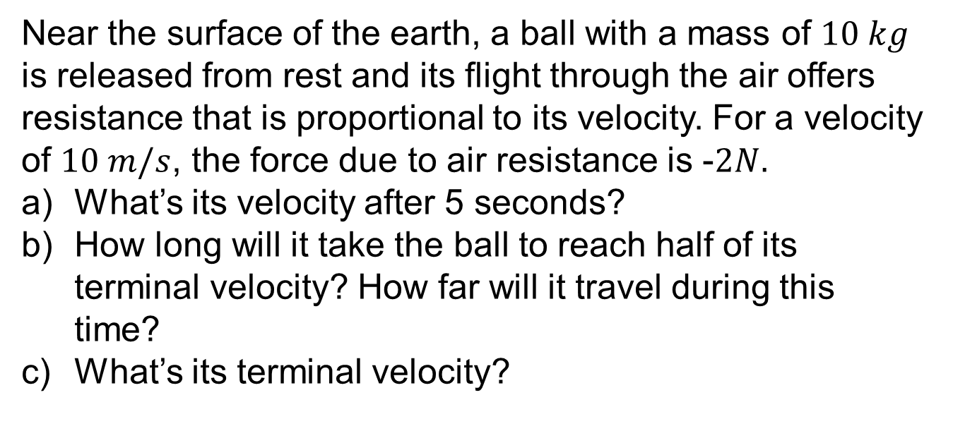
Example
Near the surface of the earth, a ball with a mass of $10 kg$ is released from rest and its flight through the air offers resistance that is proportional to its velocity. For a velocity of $10 m/s$, the force due to air resistance is -$2N.$
What’s its velocity after 5 seconds?
How long will it take the ball to reach half of its terminal velocity? How far will it travel during this time?
What’s its terminal velocity?

Slide 6
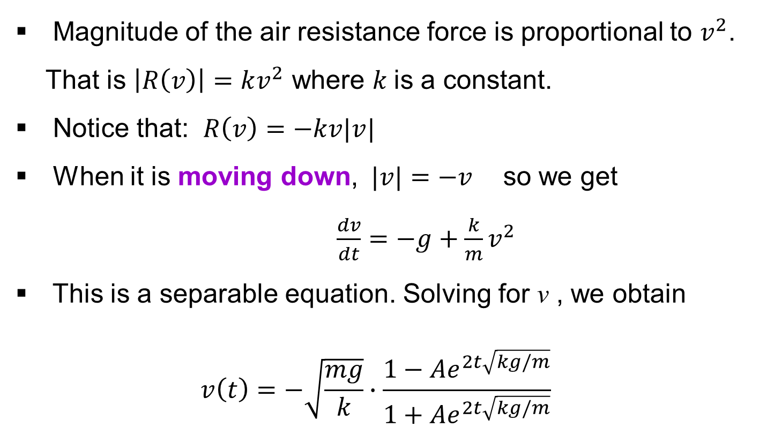
Model II
with air resistance
Magnitude of the air resistance force is proportional to $v^{2}$. That is $\left|R\left(v\right)\right|=kv^{2}$ where $k$is a constant.
Notice that: $R\left(v\right)=−kv|v|$
When it is moving down, $|v|=−v$ so we get
$\frac{dv}{dt}=−g+\frac{k}{m}v^{2}$
This is a separable equation. Solving for v , we obtain
$$v\left(t\right)=−\sqrt{\frac{mg}{k}}∙\frac{1−Ae^{2t\sqrt{kg/m}}}{1+Ae^{2t\sqrt{kg/m}}}$$

Slide 7
Model II
with air resistance
$$v\left(t\right)=\frac{dx}{dt}=−\sqrt{\frac{mg}{k}}∙\frac{1−Ae^{2t\sqrt{kg/m}}}{1+Ae^{2t\sqrt{kg/m}}}$$
Note that as $t→∞, v→−\sqrt{\frac{mg}{k}}$ , the terminal velocity.
Note that $\frac{dv}{dt}=\frac{dv}{dx}∙\frac{dx}{dt}=\frac{dv}{dx}∙v$ , the original equation (on the downward direction) could be written in the follow form: $\frac{dv}{dx}v=−g+\frac{k}{m}v^{2}$

Slide 8
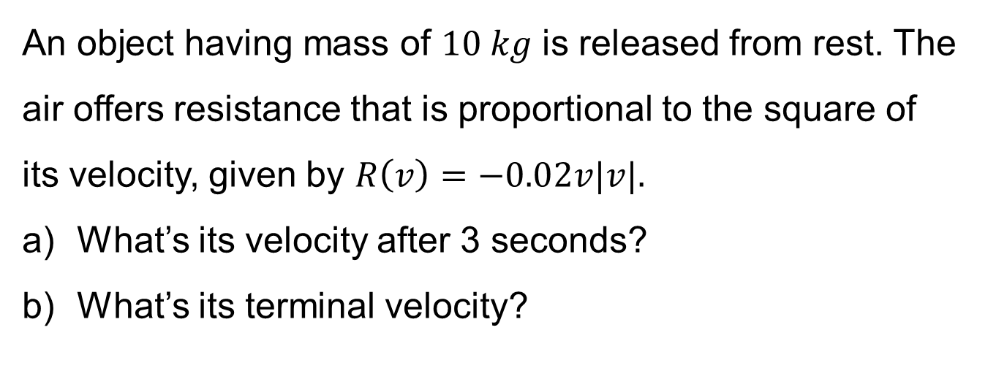
Example
An object having mass of $10 kg$ is released from rest. The air offers resistance that is proportional to the square of its velocity, given by $R\left(v\right)=−0.02v|v|.$
What’s its velocity after 3 seconds?
What’s its terminal velocity?

