Slide 1
2.4
Linear Equation

Slide 2
Definition
An equation of the form$x^{′}=a\left(t\right)∙x+f(t)$ is called a first-order linear equation. If $f\left(t\right)=0$, it’s called a homogeneous equation.
Examples of linear equations:
Homogeneous equations are separable equations!
Examples of non-linear equations:
$$x^{′}=3t\cos{t x}−7t^{2}$$
$$y^{′}=\sin{t ∙y}$$
$${3t x}^{′}=e^{2t}x−5$$
$$x^{′}=\cos{x}−7$$
$$y^{′}=4y^{2}−5$$
$$y^{′}=4yy^{′}−2t$$

Slide 3
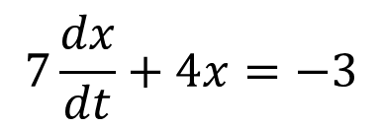
Integrating Factor Technique
$$x^{′}=a\left(t\right)∙x+f(t)$$
Rewrite the equation as $x^{′}−a\left(t\right)∙x=f(t)$
Find the integrating factor$u\left(t\right)=e^{−\int{a\left(t\right)dt}}$
Multiply both sides by $u\left(t\right)$ and get $ux^{′}−uax=uf$ which becomes ${\left(ux\right)}^{′}=uf$
Integrate both sides to obtain $ux=\int{u\left(t\right)f\left(t\right) dt}$
Solve for $x\left(t\right)$
Examples:
$$x^{′}=3x+8$$
$$y^{′}=5t−2ty$$
$$7\frac{dx}{dt}+4x=−3$$

Slide 4
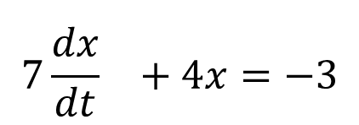
Variation of Parameters
$$x^{′}=a\left(t\right)∙x+f(t)$$
Find a particular solution to the associated homogeneous equation $x^{′}=a\left(t\right)∙x$ . Its solution is $x_{h}(t)=e^{\int{a\left(t\right)dt}}$
Substitue $x=v(t)x_{h}$ into the equation to solve for $v(t)$. Its solution would be $v′=\frac{f\left(t\right)}{x_{h}}$
The general solution would be $x\left(t\right)=v(t)∙x_{h}(t)$
Examples:
$$x^{′}=3x+8$$
$$y^{′}=5t−2ty$$
$${7\frac{dx}{dt}}^{}+4x=−3$$

Slide 5
Structure of the solution
Theorem:
If $x_{p}(t)$ is a particular solution to $x^{′}=a\left(t\right)∙x+f(t)$ and $x_{h}(t)$ is a particular solution to its associated homogeneous equation, then every solution of the linear equation is of the form:
$$x\left(t\right)=x_{p}(t)+A∙x_{h}(t)$$

