Slide 1
2.5
Mixing Problems

Slide 2
Modeling Mixing Problems
In these problems we will start with a substance that is dissolved in a liquid. Liquid will be entering and leaving a holding tank. The liquid entering the tank may or may not contain more of the substance dissolved in it. Liquid leaving the tank will of course contain the substance dissolved in it. If x(t) gives the amount of the substance dissolved in the liquid in the tank at any time t we want to develop a differential equation that, when solved, will give us an expression for x(t).
rate of change of x(t) = rate in – rate out
rate of change of ${x\left(t\right)=x}^{′}\left(t\right)=\frac{dx}{dt}$.
rate in = flow rate of liquid entering $×$ concentration.
rate out = flow rate of liquid exiting$×$ concentration.
where concentration is given by $\frac{x(t)}{V}$

Slide 3

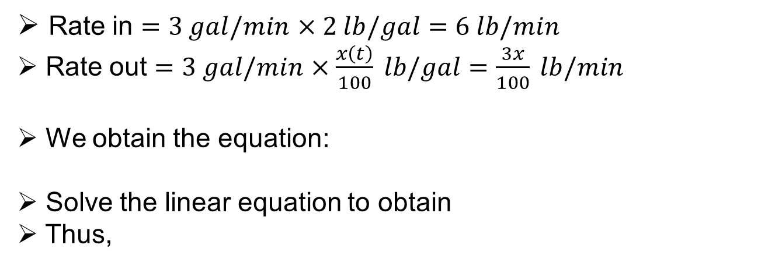
Example
A tank initially holds 100 gal of pure water. At time t = 0, a solution containing 2 lb of salt per gallon begins to enter the tank at the rate of 3 gal/min. At the same time a drain is opened at the bottom of the tank so that the volume of solution in the tank remains constant. How much salt is in the tank after 60 minutes?
Solution: Let x(t) be the amount of salt (in lbs) after t min.
Note that x(0)=0.
Rate in $=3 gal/min$ $×2 lb/gal=6 lb/min$
Rate out $=3 gal/min$ $×\frac{x\left(t\right)}{100} lb/gal=\frac{3x}{100} lb/min$
We obtain the equation:
Solve the linear equation to obtain
Thus,
$$\frac{dx}{dt}=6−\frac{3x}{100}$$
$$x(t)=200−200e^{−0.03t}$$
$$x\left(60\right)≈167 lbs$$

Slide 4
Assumptions
Substance will mix instantaneously and homogenously when entering the tank.
Holding tank: water dispenser, river, heart, kidney, brain, house, etc.
Liquid: water, blood, air, etc.
Substance: pollutant, alcohol, poison, CO gas, etc.

Slide 5
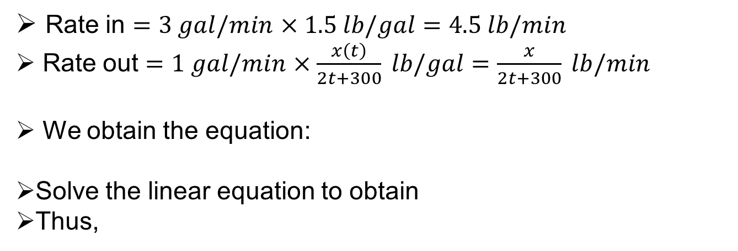
Example
The 600-gal tank is filled with 300 gal of pure water. A salt solution containing 1.5 lb of salt per gallon of solution begins flowing into the tank at a rate of 3 gal/min. Simultaneously, a drain is opened at the bottom of the tank allowing the solution to leave the tank at a rate of 1 gal/min. What will the salt content in the tank as the precise moment when the tank is completely full?
Solution: Let x(t) be the amount of salt (in lbs) after t min.
Note that x(0) = 0 and the volume of the tank is NOT constant.
Its volume is V(t)= 2t + 300. When V = 600, t = 150 min.
Rate in $=3 gal/min$ $×1.5 lb/gal=4.5 lb/min$
Rate out $=1 gal/min$ $×\frac{x\left(t\right)}{2t+300} lb/gal=\frac{x}{2t+300} lb/min$
We obtain the equation:
Solve the linear equation to obtain
Thus,
$$\frac{dx}{dt}=4.5−\frac{x}{2t+300}$$
$$x\left(t\right)=450+3t−\frac{4500\sqrt{3}}{\sqrt{2t+300}}$$
$$x\left(150\right)≈582 lbs$$

Slide 6
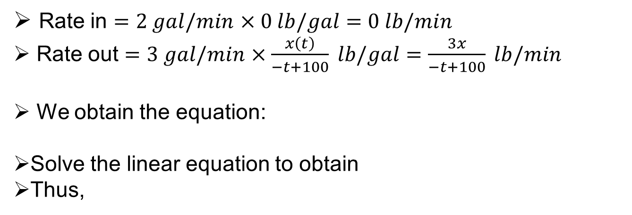
Example
A tank initially contains 100 gal of a salt-water solution containing 0.05 lb of salt for each gallon of water. At time zero, pure water is poured into the tank at a rate of 2 gal/min. Simultaneously, a drain is opened at the bottom of the tank that allows the solution to leave the tank at a rate of 3 gal/min. What will be the salt content in the tank when precisely 50 gal of salt solution remain?
Solution: Let x(t) be the amount of salt (in lbs) after t min.
Note that x(0) = 100(0.05) = 5 lbs and the volume of the tank is
V(t)= -t + 100. When V = 50, t = 50 min.
Rate in $=2 gal/min$ $×0 lb/gal=0 lb/min$
Rate out $=3 gal/min$ $×\frac{x\left(t\right)}{−t+100} lb/gal=\frac{3x}{−t+100} lb/min$
We obtain the equation:
Solve the linear equation to obtain
Thus,
$$\frac{dx}{dt}=0−\frac{3x}{−t+100}$$
$$x\left(t\right)=5×{10}^{6}∙{\left(100−t\right)}^{3}$$
$$x\left(50\right)≈0.625 lb$$

