Slide 1
3.3
Personal Finance

Slide 2
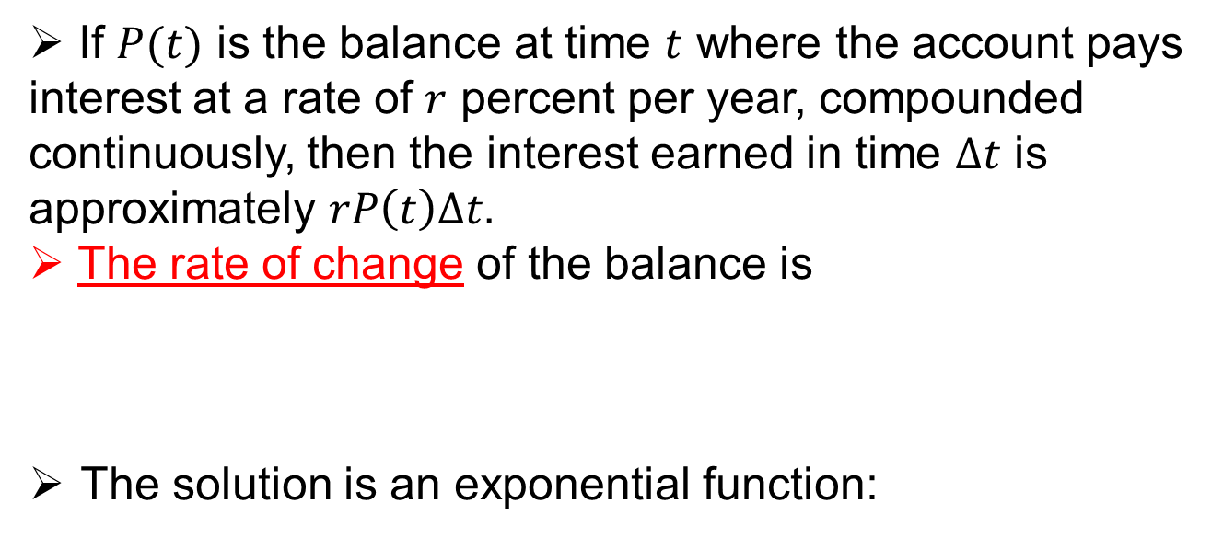
Compound Interest
If $P(t)$ is the balance at time $t$ where the account pays interest at a rate of $r$ percent per year, compounded continuously, then the interest earned in time $∆t$ is approximately $rP\left(t\right)∆t.$
The rate of change of the balance is
The solution is an exponential function:
$$P^{′}\left(t\right)=\lim_{∆t→0}{\frac{P\left(t+∆t\right)−P(t)}{∆t}=rP(t)}$$
$$P\left(t\right)=P_{0}∙e^{rt}$$

Slide 3
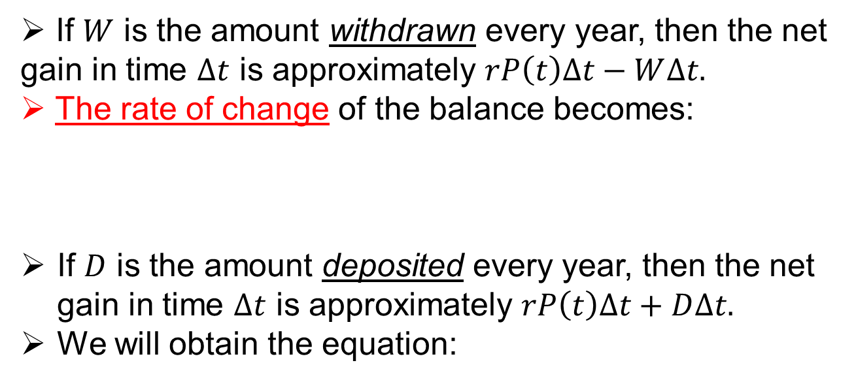
Steady Withdrawal/Deposits
If $W$ is the amount withdrawn every year, then the net gain in time $∆t$ is approximately $rP\left(t\right)∆t−W∆t.$
The rate of change of the balance becomes:
If $D$ is the amount deposited every year, then the net gain in time $∆t$ is approximately $rP\left(t\right)∆t+D∆t.$
We will obtain the equation:
$$P^{′}\left(t\right)=\lim_{∆t→0}{\frac{P\left(t+∆t\right)−P(t)}{∆t}=rP\left(t\right)−W}$$
x
$$P^{′}(t)=rP\left(t\right)+D$$

Slide 4
Examples
1) Jason opens an account with an initial investment of $2000. The annual interest rate is 5%. If the interest is continuously compounded and Jason makes an additional $1000 deposit every year, what will be the balance at the end of 10 years?
2) On the day of his birth, Jaylen’s mother pledges to make available $50,000 on his 18th birthday for his college education. She negotiates an account paying 6.25% APR, compounded continuously, with no initial deposit, but agrees to deposit a fixed amount each year. What annual deposit should be made to reach her goal?
3) Lori wants to buy a new car. Her loan officer tells her that her annual rate is 8%, compounded continuously, over a four-year term. Lori can make equal monthly payments of $225. How much can Lori afford to borrow?

