Slide 1
4.1
Definitions and Examples

Slide 2
Definitions
A second-order differential equation is an equation of the form $y^{′′}=f\left(t,y,y^{′}\right).$
A second-order linear equation has the form:
$$y^{′′}+P(t)y^{′}+q\left(t\right)y=f(t)$$
Its associated homogeneous equation has the form: $y^{′′}+P\left(t\right)y^{′}+q\left(t\right)y=0.$
Examples:
$F=ma=mx′′$ is a second-order equation.
$y^{′′}+5ty^{′}−e^{t}y=t^{2}cos{t }$ is a second-order linear equation.
$y^{′′}+y=0$ is a second-order homogeneous equation.

Slide 3
Definitions
Two functions $u$ and $v$ are linearly independent on an interval if neither is a constant multiple of the other on that interval. If one is constant multiple of the other, they are said to be linearly dependent.
Examples:
$u=e^{3x}, v={3e}^{x}$
$u={\left(x+3\right)}^{2}, v=2x^{2}+12x+18$
$u=\sin{x, v=\cos{x}}$
$u=4\sin{2x}, v=\sin{x\cos{x}}$
A linear combination of two functions u and v is a function of the form $Au+Bv$ where A and B are constants.
The Wronskian of two functions u and v is defined to be $W\left(t\right)=det\left(\begin{matrix}u & v \\ u′ & v′\end{matrix}\right)=uv^{′}−vu′$

Slide 4
Propositions
Suppose$u$ and $v$ are both solutions to the homogeneous equation
then
$$y^{′′}+P\left(t\right)y^{′}+q\left(t\right)y=0$$
A linear combination of $u$ and $v$ is also a solution to the equation.
If $u$ and $v$ are linearly independent, then the linear combination of $u$ and $v$ is the general solution to the equation; that is, $y=Au+Bv$ is the general solution.
They are linearly independent if and only if their Wronskian $W(t)≠0$ for some t.

Slide 5
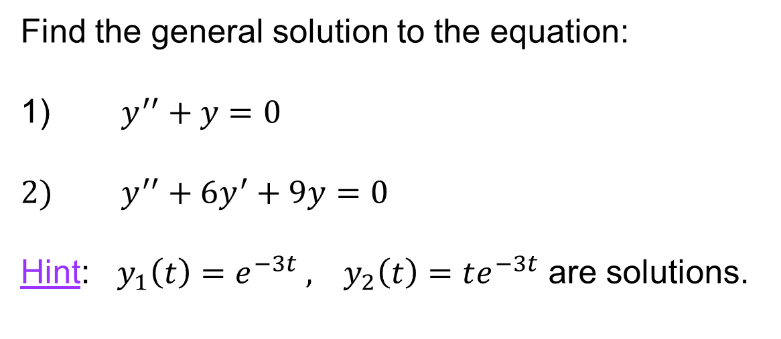
Examples
Find the general solution to the equation:
1) $y^{′′}+y=0$
2) $y^{′′}+6y^{′}+9y=0$
Hint: $y_{1}\left(t\right)=e^{−3t} , y_{2}\left(t\right)=te^{−3t}$ are solutions.

