Slide 1
4.3
Linear homogeneous Equations
With Constant Coefficients

Slide 2
Examples
Solve the following equations:
$y′′−5y′+4y=0$
$y^{′′}+4y=0$
$y^{′′}−4y^{′}+4y=0$
Hint: Exponential functions $y=e^{?t}$

Slide 3
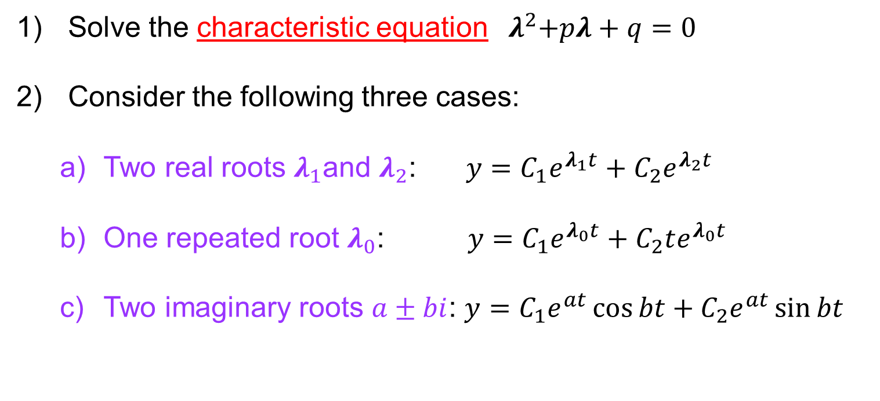
Strategy
$$y^{′′}+P\left(t\right)y^{′}+q\left(t\right)y=0$$
Solve the characteristic equation ${ λ}^{2}+pλ+q=0$
Consider the following three cases:
Two real roots $λ_{1}$and $λ_{2}$: $y=C_{1}e^{λ_{1}t}+C_{2}e^{λ_{2}t}$
One repeated root $λ_{0}$: $y=C_{1}e^{λ_{0}t}+C_{2}te^{λ_{0}t}$
Two imaginary roots $a±bi$: $y=C_{1}e^{at}\cos{bt}+C_{2}e^{at}\sin{bt}$

Slide 4
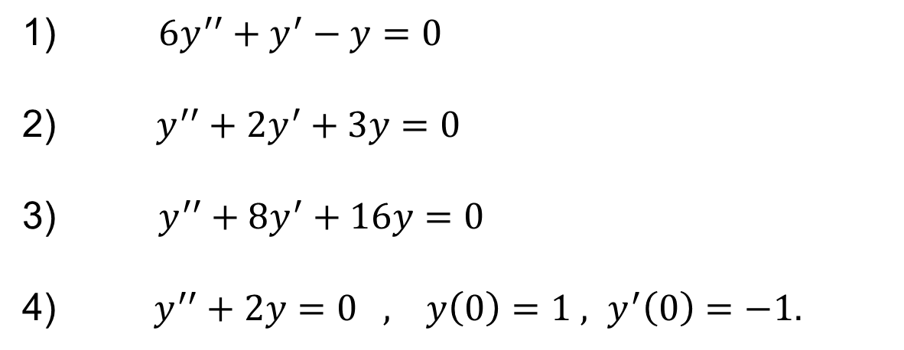
Examples
Solve the following equations:
$6y^{′′}+y^{′}−y=0$
$y^{′′}+2y^{′}+3y=0$
$y^{′′}+8y^{′}+16y=0$
$y^{′′}+2y=0 , y\left(0\right)=1 , y^{′}\left(0\right)=−1.$

