Slide 1
Chapter 5
The Laplace Transform

Slide 2
Overview
Laplace Transform is a useful technique to solve linear O.D.E. with constant coefficients.
Analogies: Suppose I have a scale with maximum weight of 1000 lbs, but I want find out the weight of an object that is much heavier than that limit. How can I do that?
Transport the object to a different planet with smaller gravity, and weigh it there.
Burn the object and weigh its ash.
Laplace transform is like, “transform” an object into a different object in a completely different world where it’s much easier to handle there, and then transform it back to our world and interpret its result.

Slide 3
Strategy
There will be three steps in this technique:
Transform the equation. (Transport the object to a different planet or burn it.)
Solve the transformed equation. (weighs the object on a different planet, or weigh its ash)
Inverse transform the solution. (Transport the object/scale back to the earth, or convert the weight of its ash to the original weight)
Potential Problem: The object may be too huge to be transformed (too big to be transported or burned)

Slide 4
5.1
The Definitions of the
Laplace Tranform

Slide 5
Definitions
A function is piecewise continuous if it has finitely many points of discontinuity and it has left-hand and right-hand limits at every point of discontinuity.
A function is piecewise differentiable if it is continuous and its derivative is piecewise continuous.
Examples:
$f(x)=|x|$ is a piecewise differentiable function.
$g\left(t\right)=\left\{\begin{aligned}1 , 0≤t≤3 \\ 0 , t>3 \end{aligned}\right.$ is piecewise continuous function.
$h\left(x\right)=\tan{x}$ is NOT a piecewise continuous function.

Slide 6
Definitions
A functions$f(t)$ is of exponential order if there are constants $C$ and $a$ such that $|f\left(t\right)|≤Ce^{at}$; that is, $f\left(t\right)$ does not grow more rapidly than all exponential functions!
Examples:
$f\left(t\right)=e^{3t}, g\left(x\right)={5x}^{27}+7x$ are of exponential order.
$h(t)=4^{t^{3}}, k(x)=e^{5^{t}}$ are NOT of exponential order.
One type of Improper integral is of the form
$\int_{a}^{∞}{f\left(x\right)dx}=\lim_{b→∞}{\int_{a}^{b}{f\left(x\right) dx}}$
We will be working with piecewise continuous or differentiable functions of exponential order in this chapter!

Slide 7
Laplace Transform
The Laplace Transform of a function $f\left(t\right)$ is the function L$\{f\left(t\right)\}=F\left(s\right)=\int_{0}^{∞}{f\left(t\right){∙e}^{−st}}dt for s>0$
This integral may diverge!
Examples: Find the Laplace transform of $f\left(t\right)$.
$f\left(t\right)=e^{at} → F\left(s\right)=\frac{1}{s−a}$
$f\left(t\right)=1 → F(s)=\frac{1}{s}$
$f\left(t\right)=t → F(s)=\frac{1}{s^{2}}$
$f\left(t\right)=t^{n} → F(s)=\frac{n!}{s^{n+1}}$
Theorem:
If $f(t)$ is a function on the interval $[0,∞)$ of exponential order,
then the Laplace transform exists for large values of $s$.

Slide 8
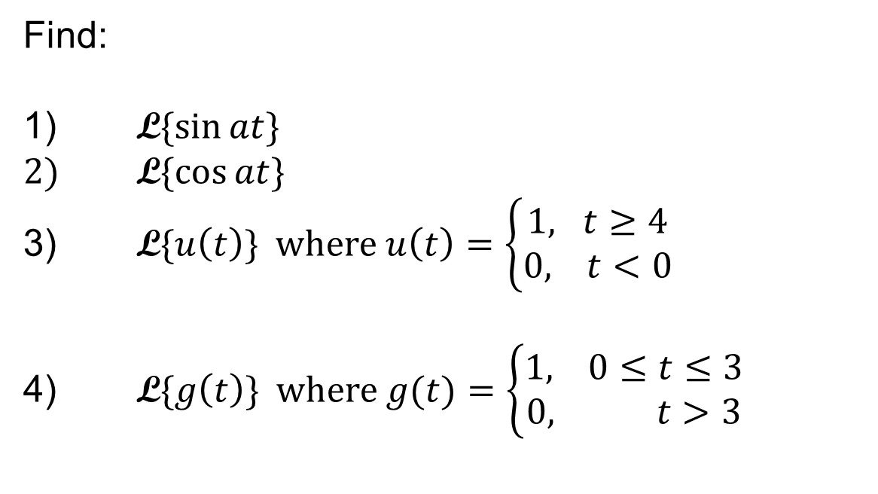
Examples
Find:
1) $\text{L}\{\sin{at\}}$
2) $\text{L}\{\cos{at\}}$
3) $\text{L}\{u\left(t\right)\}$ where $u\left(t\right)=\left\{\begin{aligned}1, t≥4 \\ 0, t<0\end{aligned}\right.$
4) $\text{L}\{g\left(t\right)\}$ where $g(t)=\left\{\begin{aligned}1, 0≤t≤3 \\ 0, t>3\end{aligned}\right.$

