Slide 1
5.3
The Inverse Laplace Tranform

Slide 2
Inverse Laplace Transform
Theorem:
If L$\left\{f\left(t\right)\right\}=\text{L}\left\{g\left(t\right)\right\}$, then $f\left(t\right)=g\left(t\right)$ for all $t>0.$
Definition:
If $F(s)$ is the Laplace Transform of $f(t)$, then $f(t)$ is called the inverse Laplace Transform of $F(s)$, and we write $f\left(t\right)={\text{L}}^{−1}\{F\left(s\right)\}$
Examples: Find the inverse Laplace Transform.
${\text{L}}^{−1}\left\{\frac{1}{s}\right\}$
${\text{L}}^{−1}\left\{\frac{3}{s^{2}+9}\right\}$
${\text{L}}^{−1}\left\{\frac{1}{s−4}\right\}$
${\text{L}}^{−1}\left\{\frac{s−5}{{(s−5)}^{2}+16}\right\}$

Slide 3
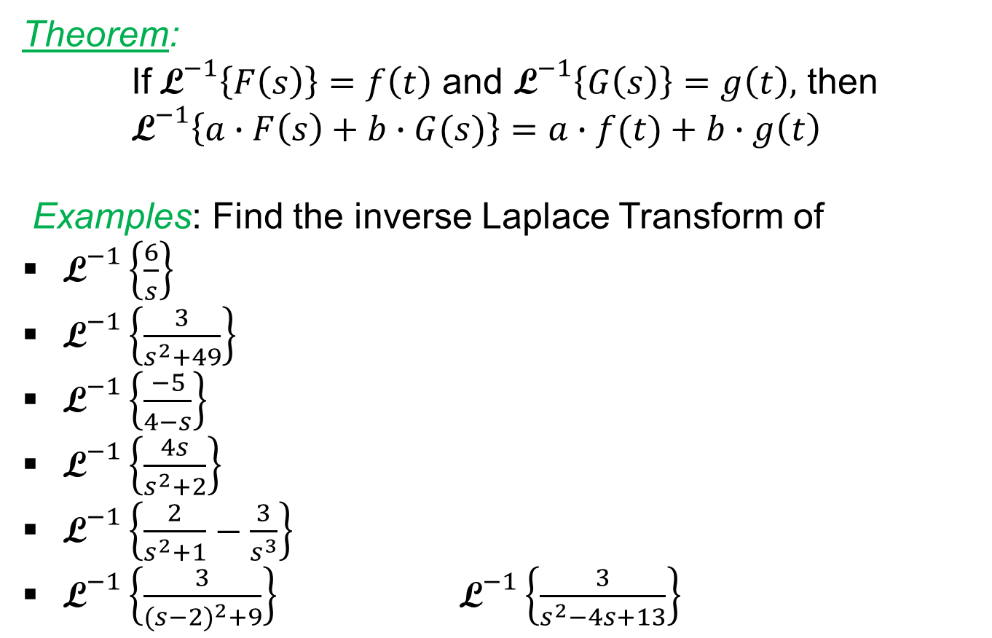
Properties
Theorem:
If${\text{L}}^{−1}\left\{F\left(s\right)\right\}=f\left(t\right)$ and ${\text{L}}^{−1}\left\{G\left(s\right)\right\}=g\left(t\right),$ then
${\text{L}}^{−1}\left\{a∙F\left(s\right)+b∙G(s)\right\}=a∙f(t)+b∙g\left(t\right)$
Examples: Find the inverse Laplace Transform of
${\text{L}}^{−1}\left\{\frac{6}{s}\right\}$
${\text{L}}^{−1}\left\{\frac{3}{s^{2}+49}\right\}$
${\text{L}}^{−1}\left\{\frac{−5}{4−s}\right\}$
${\text{L}}^{−1}\left\{\frac{4s}{s^{2}+2}\right\}$
${\text{L}}^{−1}\left\{\frac{2}{s^{2}+1}−\frac{3}{s^{3}}\right\}$
${\text{L}}^{−1}\left\{\frac{3}{{(s−2)}^{2}+9}\right\}$ ${\text{L}}^{−1}\left\{\frac{3}{s^{2}−4s+13}\right\}$

Slide 4

Table of Laplace Transform
L$\left\{1\right\}=\frac{1}{s}$ L$\left\{e^{ct}\right\}=\frac{1}{s−c}$
L$\left\{t^{n}\right\}=\frac{n!}{s^{n+1}}$ L$\left\{{e^{ct}t}^{n}\right\}=\frac{n!}{{\left(s−c\right)}^{n+1}}$
L$\left\{\sin{at}\right\}=\frac{a}{s^{2}+a^{2}}$ L$\left\{e^{ct}\sin{at}\right\}=\frac{a}{{(s−c)}^{2}+a^{2}}$
L$\left\{\cos{at}\right\}=\frac{s}{s^{2}+a^{2}}$ L$\left\{e^{ct}\cos{at}\right\}=\frac{s−c}{{(s−c)}^{2}+a^{2}}$

Slide 5
Examples
Find the inverse Laplace Transform.
${\text{L}}^{−1}\left\{\frac{1}{s^{2}−s−12}\right\}$
${\text{L}}^{−1}\left\{\frac{5}{s^{2}+4s+9}\right\}$
${\text{L}}^{−1}\left\{\frac{s}{s^{2}−8s+17}\right\}$
${\text{L}}^{−1}\left\{\frac{1}{{\left(s−1\right)}^{2}(s^{2}−9)}\right\}$

