Slide 1
5.4
Using Laplace Transform to
Solve O.D.E.

Slide 2
Strategy for solving I.V.P.
Take the Laplace Transform on both sides of the equation where $Y\left(s\right)=\text{L}\left\{y(t)\right\}$
Convert the O.D.E. to an algebraic equation. This is a linear equation in $Y(s)$, which has the form ${a\left(s\right)∙Y\left(s\right)=b(s)}_{}$ where $a\left(s\right)$ is the characteristic equation.
Solve for $Y\left(s\right).$
Find $y\left(t\right)={\text{L}}^{−1}\left\{Y(s)\right\}$

Slide 3
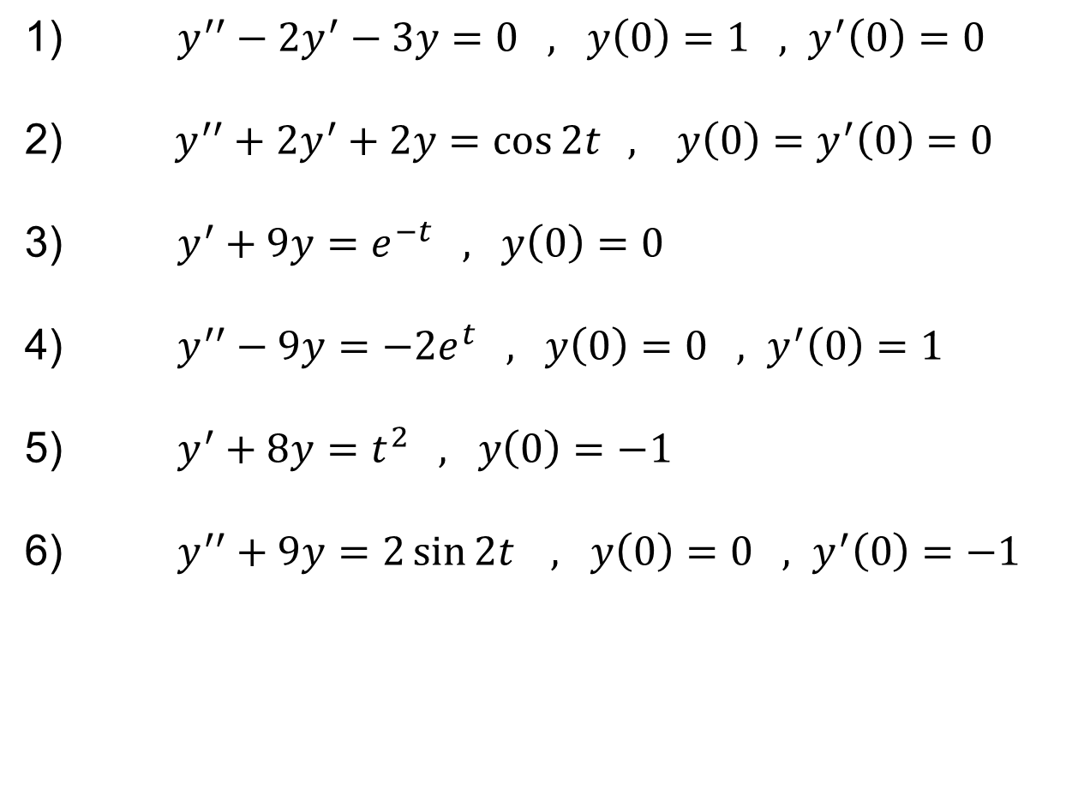
Examples
Solve the following I.V.P.
$y^{′′}−2y^{′}−3y=0 , y\left(0\right)=1 , y^{′}\left(0\right)=0$
$y^{′′}+2y^{′}+2y=\cos{2t} , y\left(0\right)=y^{′}\left(0\right)=0$
$y^{′}+9y=e^{−t} , y\left(0\right)=0$
$y^{′′}−9y=−2e^{t} , y\left(0\right)=0 , y^{′}\left(0\right)=1$
$y^{′}+8y=t^{2} , y\left(0\right)=−1$
$y^{′′}+9y=2\sin{2t} , y\left(0\right)=0 , y^{′}\left(0\right)=−1$

